Slide 1

WEEK 7 DEVELOPING SIA ARCHITECTURE
SIA 102 – SYSTEM INTEGRATION AND ARCHITECTURE 2

Slide 2
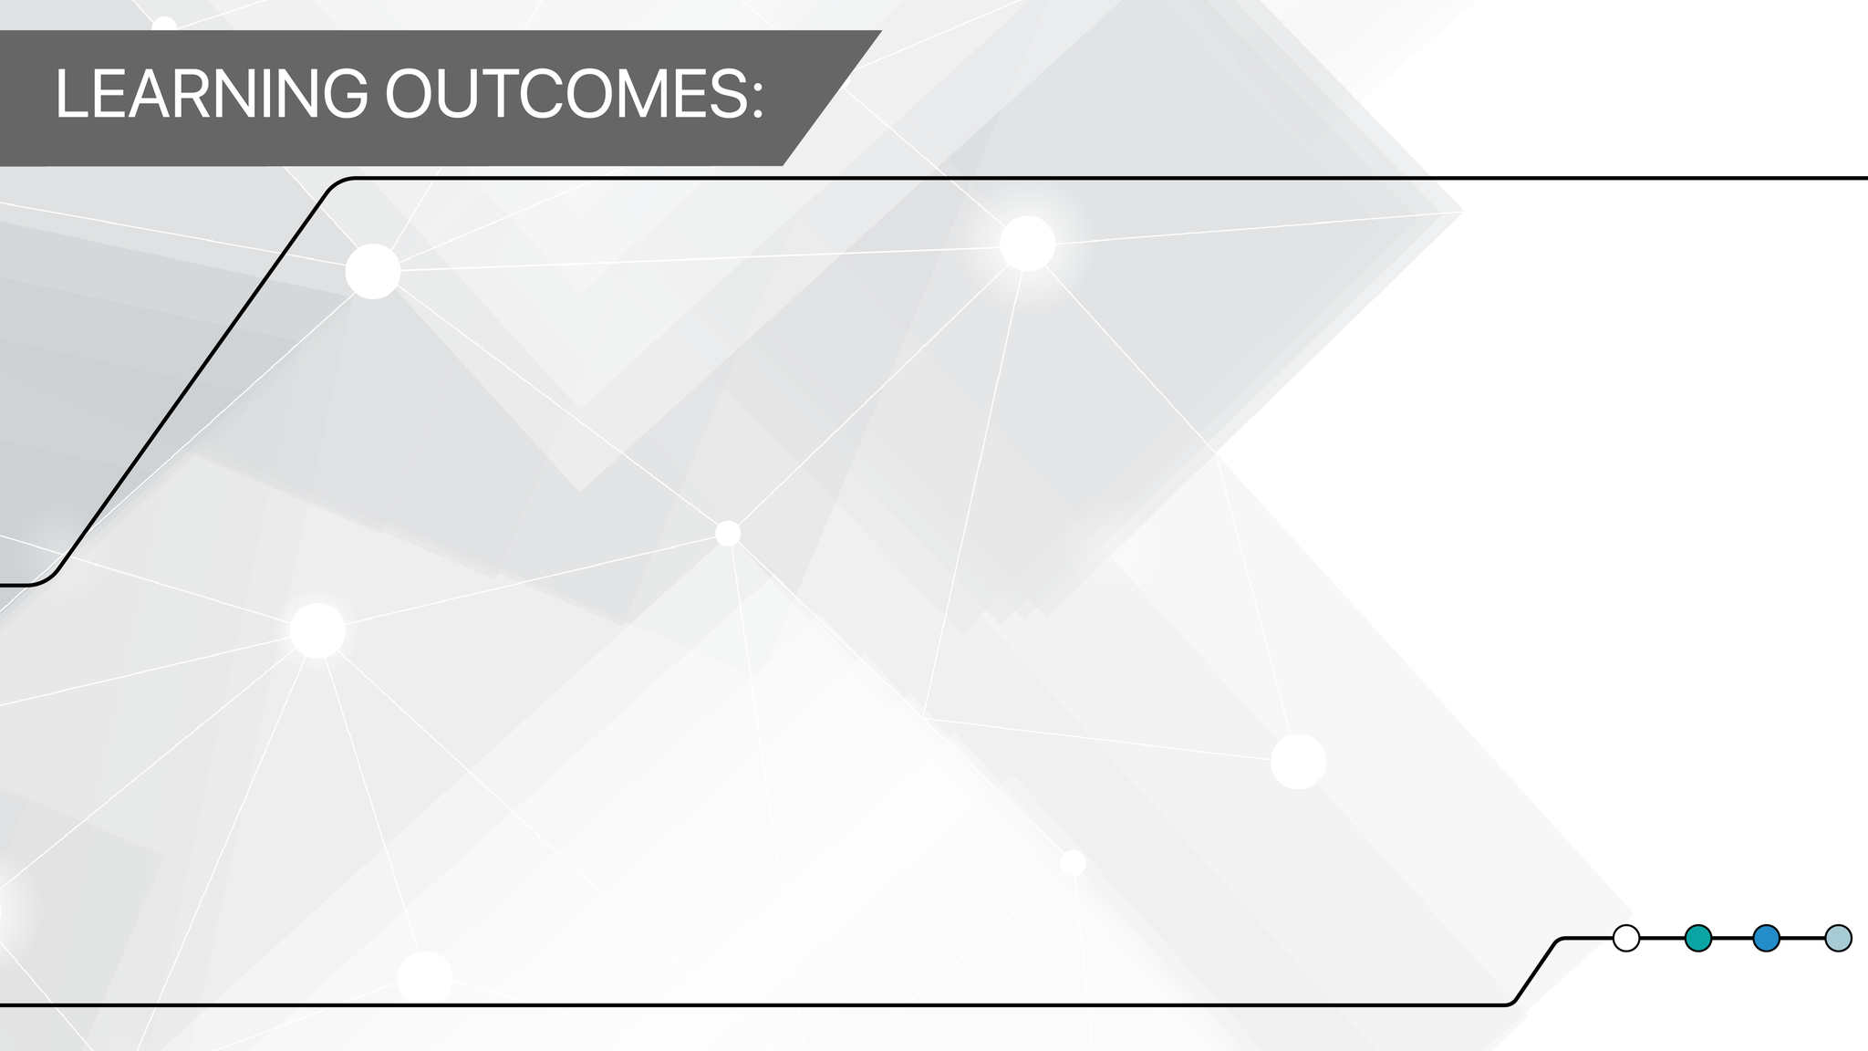
Can appreciate “architecture” in the context of system integration and architecture (IEEE std. 1471)
Can explain how complex systems can be represented using architectural views and how this facilitates system evolution over time.
Can explain how some specific architectural views relate to the system lifecycle.
SIA 102 – SYSTEM INTEGRATION AND ARCHITECTURE 2

Slide 3
Topic Outline
TOGAF and Standards for IT Architecture Description
Developing Views in the Architecture Development Method (ADM)
Core Taxonomy of Architecture Views

Slide 4
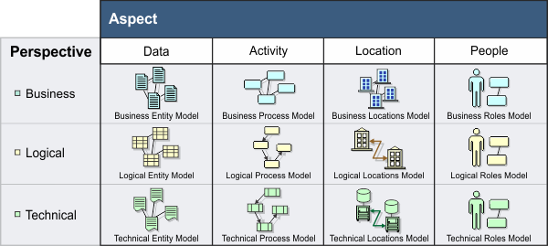
Definition of Architecture Views
Architecture Views are representations of the overall architecture that are meaningful to one or more stakeholders in the system.
Notes:
Architecture views are representations of the overall architecture that are meaningful to one or more stakeholders in the system. The architect chooses and develops a set of views that will enable the architecture to be communicated to, and understood by, all the stakeholders, and enable them to verify that the system will address their concerns.
An architecture is usually represented by means of one or more architecture models that together provide a coherent description of the system's architecture. A single, comprehensive model is often too complex to be understood and communicated in its most detailed form, showing all the relationships between the various business and technical components. As with the architecture of a building, it is normally necessary to develop multiple views of the architecture of an information system, to enable the architecture to be communicated to, and understood by, the different stakeholders in the system.
For example, just as a building architect might create wiring diagrams, floor plans and elevations to describe different facets of a building to its different stakeholders (electricians, owners, planning officials), so an IT architect might create physical and security views of an IT system for the stakeholders who have concerns related to these aspects.

Slide 5
TOGAF and Standards for IT Architecture Description
- “ANSI/IEEE Std 1471-2000” Recommended Practice for Architectural Description of Software-Intensive Systems, is also known as IEEE 1471
- It was developed by the IEEE's Architecture Working Group (AWG) under the sponsorship of the Software Engineering Standards Committee of IEEE.
Notes:
An important recent development in IT architecture practice has been the emergence of standards for architecture description, principally through the adoption by ANSI and the IEEE of ANSI/IEEE Std 1471-2000 Recommended Practice for Architectural Description of Software-Intensive Systems.
ANSI/IEEE 1471-2000 is the first formal standard to address the content and organization of architectural descriptions and it was developed by the IEEE's Architecture Working Group (AWG) under the sponsorship of the Software Engineering Standards Committee of IEEE.

Slide 6
TOGAF and Standards for IT Architecture Description
- TOGAF stands for The Open Group Architecture Framework
enterprise architecture framework
defining business goals
aligning business goals with architecture objectives around enterprise software development
Notes:
TOGAF stands for The Open Group Architecture Framework
TOGAF is an enterprise architecture framework that helps define business goals and align them with architecture objectives around enterprise software development.
As of 2020, TOGAF is the most used framework for enterprise architecture. Because it provides an approach in designing, planning, implementing, and governing an enterprise information technology architecture.

Slide 7
TOGAF and Standards for IT Architecture Description
- IEEE 1471 is promoting a consistend and systematic approach to the creation of views.
- TOGAF predates ANSI/IEEE Std 1471-2000
Notes:
One of the aims of the IEEE 1471 standard is to promote a more consistent, systematic approach to the creation of views.
TOGAF predates ANSI/IEEE Std 1471-2000. At the present time, it encourages but does not mandate the use of ANSI/IEEE Std 1471-2000.
Organizations that have incorporated, or plan to incorporate, ANSI/IEEE Std 1471-2000 into their IT architecture practice should find that none of the key concepts in TOGAF is incompatible with this standard, although some of the terminology used is not completely consistent with it.

Slide 8
Basic Concepts
System - collection of components organized to accomplish a specific function or set of functions.
Architecture - shows the relationship between the system’s components and its environment.
Architecture Description - collection of artifacts that document an architecture
Notes:
The following concepts are central to the topic of views. These concepts have been adapted from more formal definitions contained in ANSI/IEEE Std 1471-2000 Recommended Practice for Architectural Description of Software-Intensive Systems.
A system is a collection of components organized to accomplish a specific function or set of functions.
The architecture of a system is the system's fundamental organization, embodied in its components, their relationships to each other and to the environment, and the principles guiding its design and evolution.
An architecture description is a collection of artifacts that document an architecture. In TOGAF, architecture views are the key artifacts in an architecture description.

Slide 9
Basic Concepts
Stakeholders - people who have key roles in, or concerns about, the system.
Concerns - are the key interests that are crucially important to the stakeholders in the system, and determine the acceptability of the system.
View - representation of whole system from a perspective.
Notes:
Stakeholders are people who have key roles in, or concerns about, the system: for example, as users, developers, or managers. Different stakeholders with different roles in the system will have different concerns. Stakeholders can be individuals, teams, or organizations (or classes thereof).
Concerns are the key interests that are crucially important to the stakeholders in the system, and determine the acceptability of the system. Concerns may pertain to any aspect of the system' s functioning, development, or operation, including considerations such as performance, reliability, security, distribution, and evolvability.
A view is a representation of a whole system from the perspective of a related set of concerns.

Slide 10
Basic Concepts
Viewpoint - defines the perspective from which a view is taken.
how to construct and use a view
the information that should appear in the view
the modelling techniques for expressing and analysing the information
and a rationale for these choices
Notes:
In capturing or representing the design of a system architecture, the architect will typically create one or more architecture models, possibly using different tools. A view will comprise selected parts of one or more models, chosen so as to demonstrate to a particular stakeholder or group of stakeholders that their concerns are being adequately addressed in the design of the system architecture.
A viewpoint defines the perspective from which a view is taken. More specifically, a viewpoint defines: how to construct and use a view (by means of an appropriate schema or template); the information that should appear in the view; the modelling techniques for expressing and analysing the information; and a rationale for these choices (e.g., by describing the purpose and intended audience of the view).
A view is what you see. A viewpoint is where you are looking from - the vantage point or perspective that determines what you see.

Slide 11
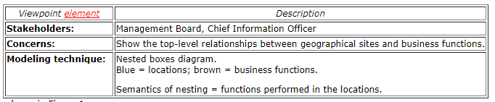
Example of Viewpoint
The viewpoint is specified as follows:
Notes:
For many architectures, a useful viewpoint is that of Business Domains, which can be illustrated by an example from The Open Group itself.
The viewpoint is specified as follows: (show table 1)

Slide 12
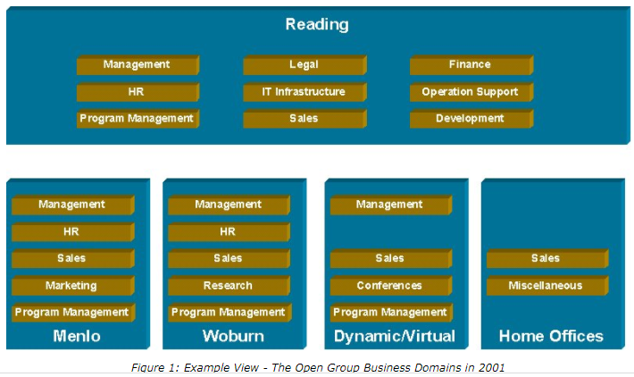
Example of View
Notes:
The corresponding view of The Open Group (in 2001) is shown in Figure 1.

Slide 13
Architecture Development Method (ADM)
The Architect has the responsibility of ensuring the following:
Completeness
- addressing concerns of its stakeholders
Integrity
- connecting views to each other
- reconciling concerns of stakeholders
- showing trade-offs (e.g. bet. security and performance)
Notes:
The choice of which particular architecture views to develop is one of the key decisions that the architect has to make.
The architect has a responsibility for ensuring the completeness (fitness-for-purpose) of the architecture, in terms of adequately addressing all the pertinent concerns of its stakeholders; and the integrity of the architecture, in terms of connecting all the various views to each other, satisfactorily reconciling the conflicting concerns of different stakeholders, and showing the trade-offs made in so doing (as between security and performance, for example).
The choice has to be constrained by considerations of practicality, and by the principle of fitness-for-purpose (i.e., the architecture should be developed only to the point at which it is fit for purpose, and not reiterated

Slide 14
Architecture Development Method (ADM)
ADM
- iterative process from business to technology
- requires identifying of concerns from different views, referring back to concerns and requirements all through out the process
Existing Environment - baseline in the ADM
Target Environment
Notes:
Architecture Development Method, the development of architecture views is an iterative process. The typical progression is from business to technology, using a technique such as Business Scenarios to properly identify all pertinent concerns; and from high level overview to lower level detail, continually referring back to the concerns and requirements of the stakeholders throughout the process.
Moreover, each of these progressions has to be made for two distinct environments:
Moreover, each of these progressions has to be made for two distinct environments: the existing environment (referred to as the baseline in the ADM) and the target environment. The architect must develop pertinent business and technical architecture views of both the existing system and the target system.

Slide 15
Core Taxonomy of Architecture Views
TOGAF Core Taxonomy
- defines the minimum set of views that should be considered in the development of an architecture.
Stakeholders
- Users
- System and Software Engineers
- Operators, Administrators, and Managers
- Acquirers
Notes:
The TOGAF's core taxonomy of architecture views defines the minimum set of views that needs to be considered when developing an architecture.
Since in ANSI/IEEE Std 1471-2000 every view has an associated viewpoint that defines it, this taxonomy may also be regarded as a taxonomy of viewpoints by those organizations that have adopted ANSI/IEEE Std 1471-2000.
Stakeholders
The minimum set of stakeholders for a system that should be considered in the development of architecture viewpoints and views is:
Users
System and Software Engineers
Operators, Administrators, and Managers
Acquirers

Slide 16
Core Taxonomy of Architecture Views
Views and Viewpoints Categories in Addressing Stakeholder Concerns
Business Architecture Views - (user of the system). Describe the flows of business information
Technical Architecture Views - (technicians)
- Engineering Views (System Software Engineers)
- Operations Views (Systems Administrator and Systems Managers)
- Acquirers Views (Procurement Personnel)
Notes:
The architecture views, and corresponding viewpoints, that may be created to support each of these stakeholders fall into the following categories. (As mentioned above, this taxonomy may be regarded as a taxonomy of viewpoints by those organizations that have adopted ANSI/IEEE Std 1471-2000.)
Business Architecture Views, which address the concerns of the users of the system, and describe the flows of business information between people and business processes
Technical Architecture Views, which address the concerns of technicians responsible for developing, acquiring, and operating the system, and in turn comprise:
Engineering Views, addessing the concerns of System and Software Engineers responsible for developing and integrating various components of the system.
Operations Views, addessing the concerns of systems administrators and systems managers
Acquirers Views, addressing the concerns of procurement personnel responsible for acquiring the commercial-off-the-shelf (COTS) software and hardware to be included in the system

Slide 17
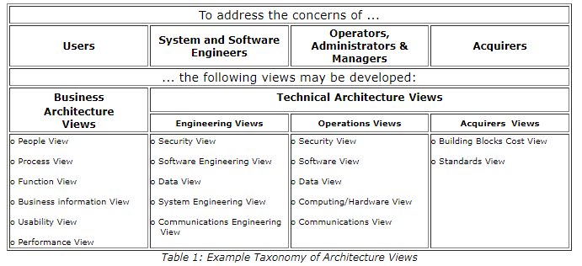
Core Taxonomy of Architecture Views
Notes:
Examples of specific views in each category are tabulated below, and explained in detail in the following subsection.
The Architect may or may not need to develop separate views for engineers and for operations personnel. Engineering views provide information needed by engineering staff to design and implement the hardware and software system. Operations Views provide information needed by Operations staff in order to operate and administer the implemented system.

Slide 18
